Slide 1
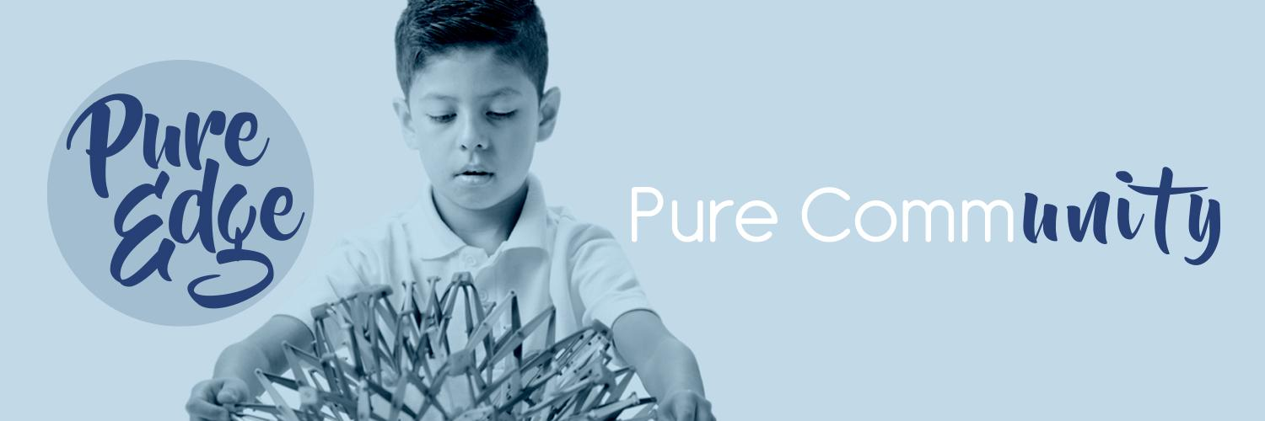



Friday October 8th 9.25am-10.25am.
Hitchcock room.
Thank you for joining us!
Session: Educator Self Care & the Neuroscience of Stress.
Trainer: Gill McClean
Follow us @pureedgeinc
Website: www.pureedgeinc.org
Email: getmoving@pureedgeinc.org
©2020 Pure Edge, Inc.

Slide 2
Introductions
Gill McClean
gill@pureedgeinc.org
Director of Professional Development & National Trainer
Follow us @PureEdgeInc
©2020 Pure Edge, Inc.

Slide 3
Who We Are
Pure Edge, Inc. (PEI) is a private operating foundation
that provides direct service to organizations through professional development & strategy thought partnership.
PEI also provides grants to national organizations that advance the work of whole child development & SEL.
Follow us @PureEdgeInc
©2020 Pure Edge, Inc.

Slide 4

Welcoming Activity
Which of the following images most accurately reflects your feelings right now.
Follow us @PureEdgeInc
©2020 Pure Edge, Inc.

Slide 5










1
2
3
4
5
8
9
10
6
7
Follow us @PureEdgeInc
©2020 Pure Edge, Inc.

Slide 6
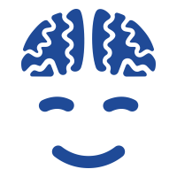
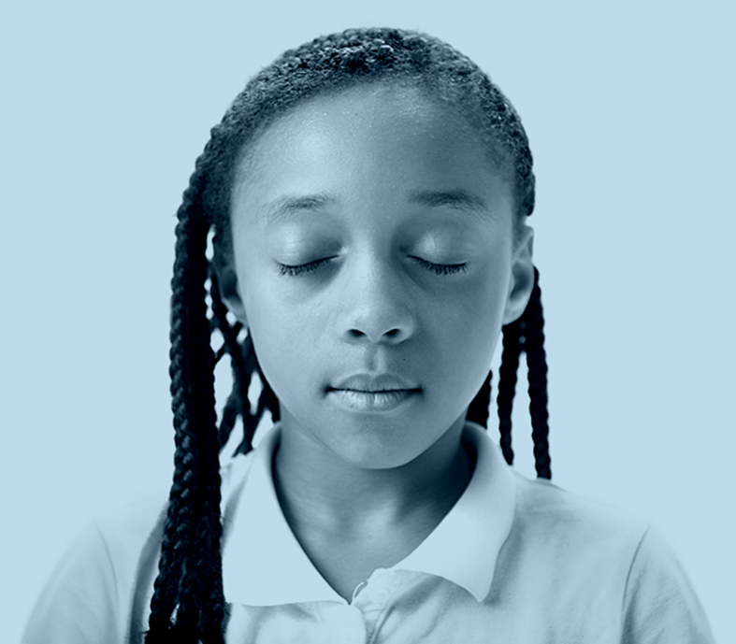
Engaging Activity: Mindful Minute
Follow us @PureEdgeInc
©2020 Pure Edge, Inc.
Notes:
Mindful Minute: Eyes closed or open. Breath awareness, body scan, check in with thoughts/feelings/energy level.

Slide 7
Learning Objectives
  Recognize the physiological response to stress.
  Experience self-care practices throughout the session.
  Explore the interconnectedness of stress, educator self-care, and negativity bias.
Follow us @PureEdgeInc
©2020 Pure Edge, Inc.

Slide 8



In order to have an impact on others, you must first have an impact on yourself.
Follow us @PureEdgeInc
©2020 Pure Edge, Inc.

Slide 9

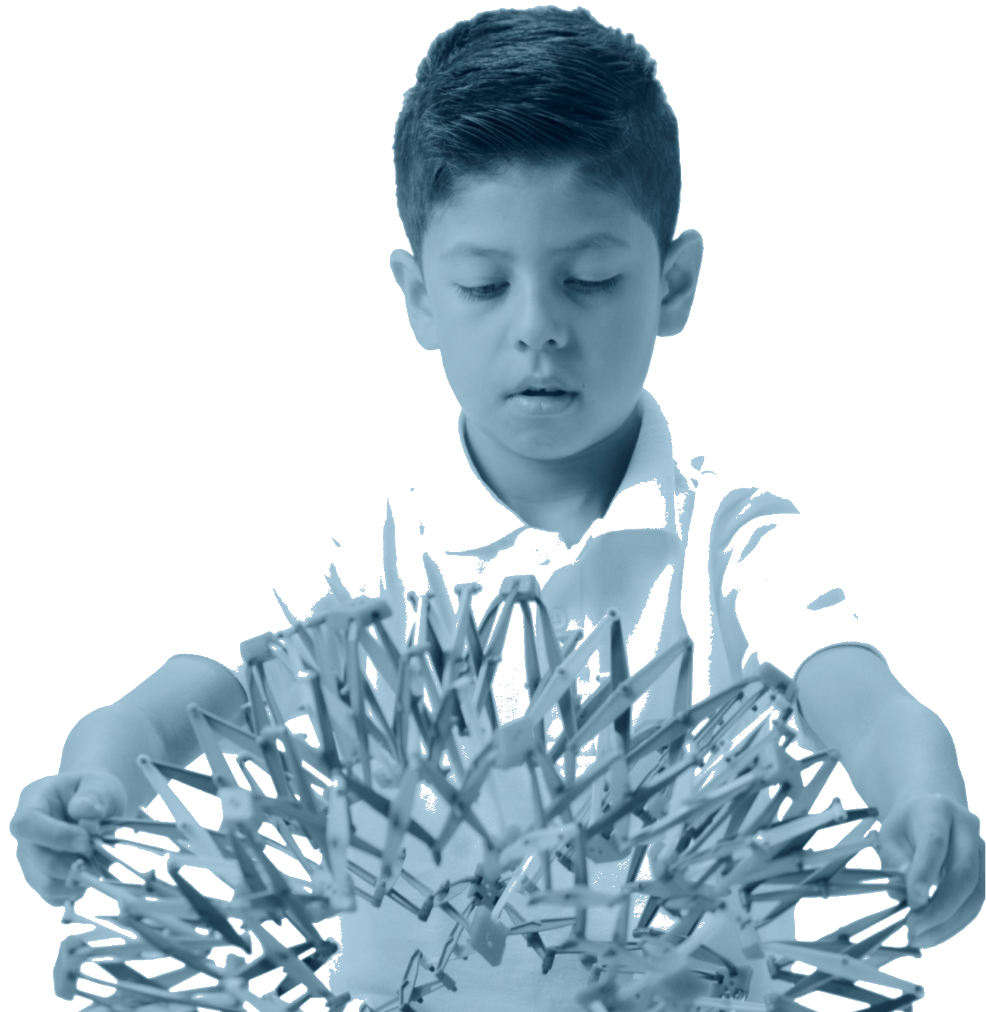


Breathe
Move
Rest
Follow us @PureEdgeInc
©2020 Pure Edge, Inc.

Slide 10
What we hope to do
  Respond
  Vs.
  React
Follow us @PureEdgeInc
©2020 Pure Edge, Inc.
Notes:
We are giving kid the tools from as young as possible to be able to respond as opposed to react. Training them to avoid having a dysregulated stress response.

Slide 11
Benefits of Nasal Breathing
Filters dust and impurities from the air
Warms the air to body temperature
The diaphragm is more easily controlled, which supports the development of internal core strength
More control over lengthening the breath (extended exhalations help activate the parasympathetic nervous system)
Increased oxygen from nasal breath increases energy and vitality
Northwestern University. "Rhythm of breathing affects memory, fear: Breathing is not just for oxygen; it's also linked to brain function, behavior." ScienceDaily. ScienceDaily, 7 December 2016. <www.sciencedaily.com/releases/2016/12/161207093034.htm>
©2020 Pure Edge, Inc.
Follow us @PureEdgeInc
Notes:
Filters dust and impurities from the air
Warms the air to body temperature
The diaphragm is more easily controlled, which supports the development of internal core strength
More control over lengthening the breath (extended exhalations help activate the parasympathetic nervous system)
Increased oxygen from nasal breath increases energy and vitality
Curriculum Level: 6-12
Unit: 1
Lesson: 1.6
Page #: 33
Curriculum Theme: Breathing Benefits
Lesson/Unit Content: "Verbally list three benefits of nasal breathing: two physical and one emotional"

Slide 12
Does It Matter How We Breathe?
Nasal Breathing & Extended Breaths
Mouth Breathing
Lung capacity increases
18% more oxygen absorbed
Heart relaxes
Respiratory & nervous systems cohere
Blood pressure decreases
Body moisture sapped
Lungs irritated
Soft tissue of mouth flexes, leaving less space to breathe
Useful when doing aerobic exercise
Follow us @PureEdgeInc
Nestor, J. (2020, May 21). The Healing Power of Proper Breathing. Retrieved from www.wsj.com/articles/the-healing-power-of-proper-breathing-11590098696
©2020 Pure Edge, Inc.

Slide 13
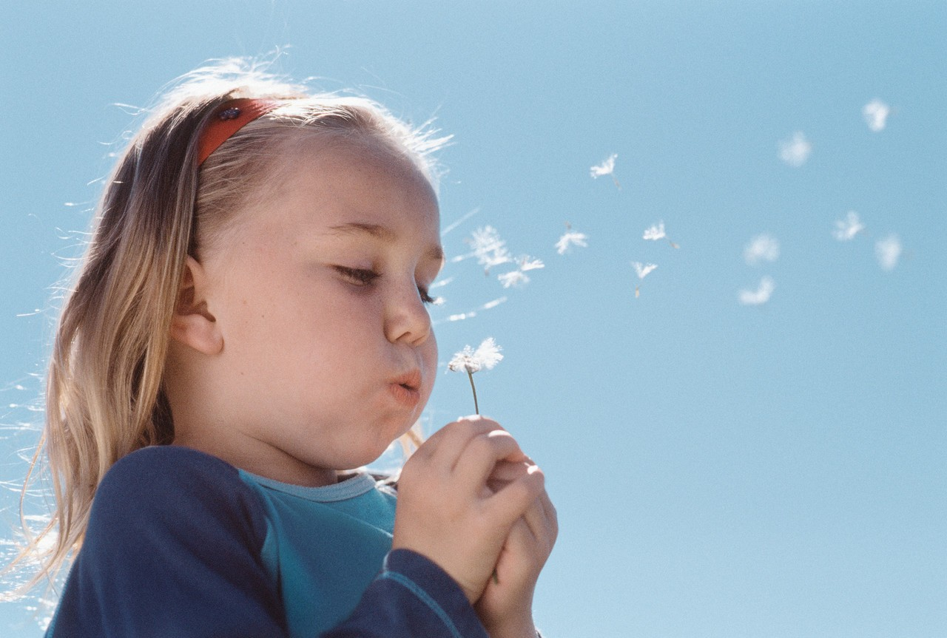
"Breathing properly can allow us to live longer and healthier lives.
[Breathing poorly can] cause:
  asthma,
  anxiety,
  attention deficit hyperactivity disorder,
  hypertension,
  and more.
Poor breathing habits can even change the physical structure of our skeletons, depleting essential minerals and weakening our bones.”
This Photo by Unknown Author is licensed under CC BY-NC
Nestor, J. (2020, May 21). The Healing Power of Proper Breathing. Retrieved from www.wsj.com/articles/the-healing-power-of-proper-breathing-11590098696
Follow us @PureEdgeInc
©2020 Pure Edge, Inc.

Slide 14
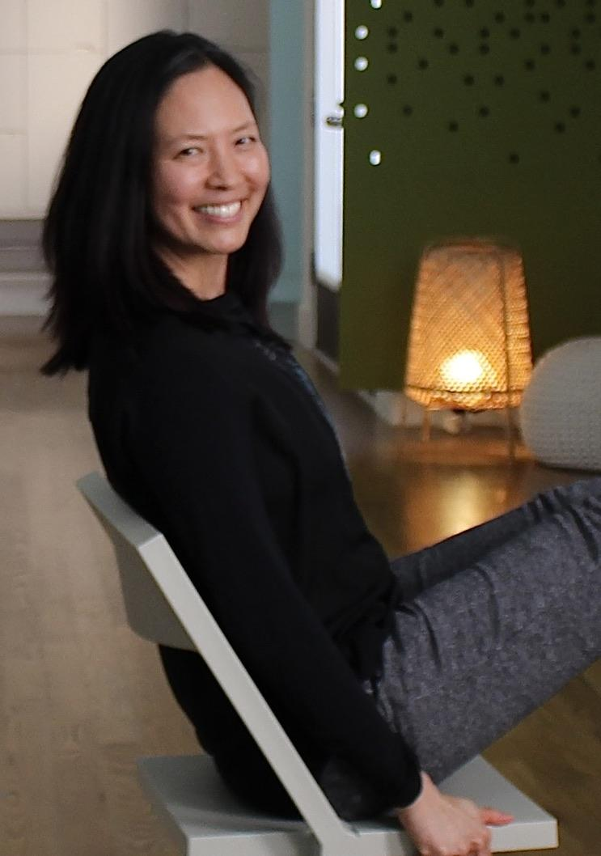
Engaging Activity: Easy In, Extend Out
Breathe in naturally.
Breathe out slowly, making the exhalation longer than the inhalation.
Keep going, making the exhalation longer than the inhalation.
Notice how you feel.
*Lengthening the exhalation tends to have a calming effect on the mind and body.
Follow us @PureEdgeInc
©2021 Pure Edge, Inc.
Notes:
1. Breathe in naturally.
2. Breathe out slowly, making the exhalation longer than the inhalation.
3. Keep going, making the exhalation longer than the inhalation.
4. Notice how you feel.
*Lengthening the exhalation tends to have a calming effect on the mind and body.

Slide 15

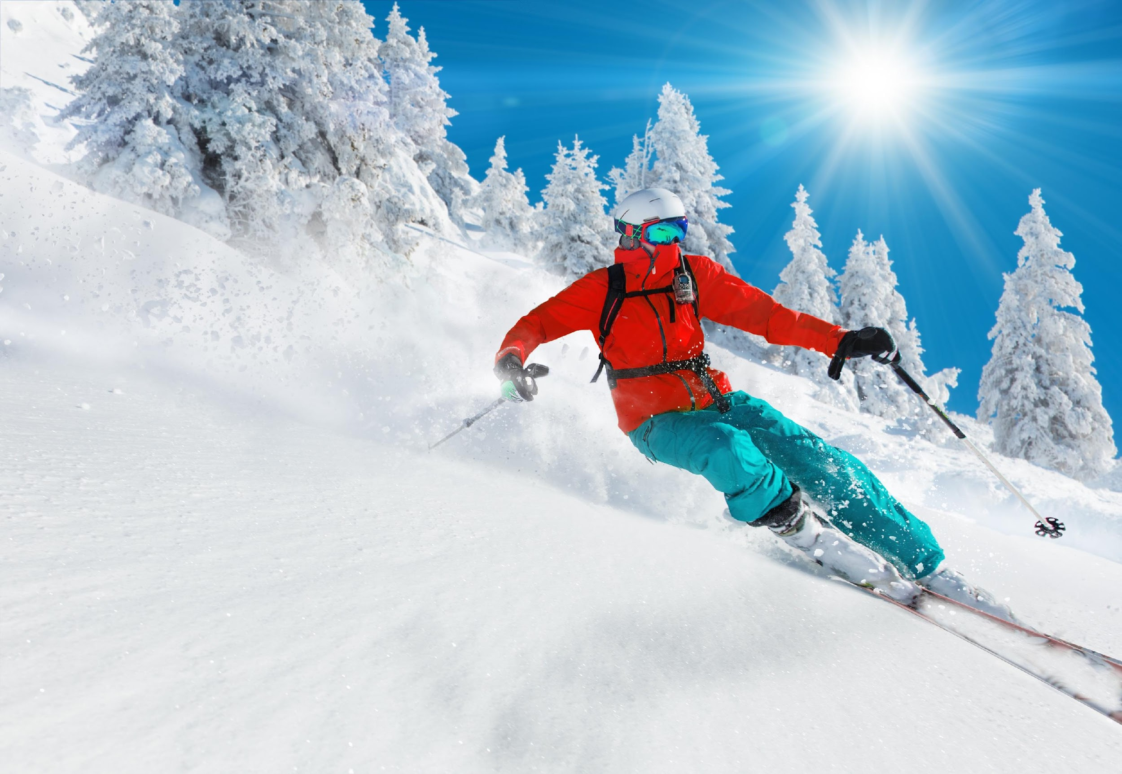
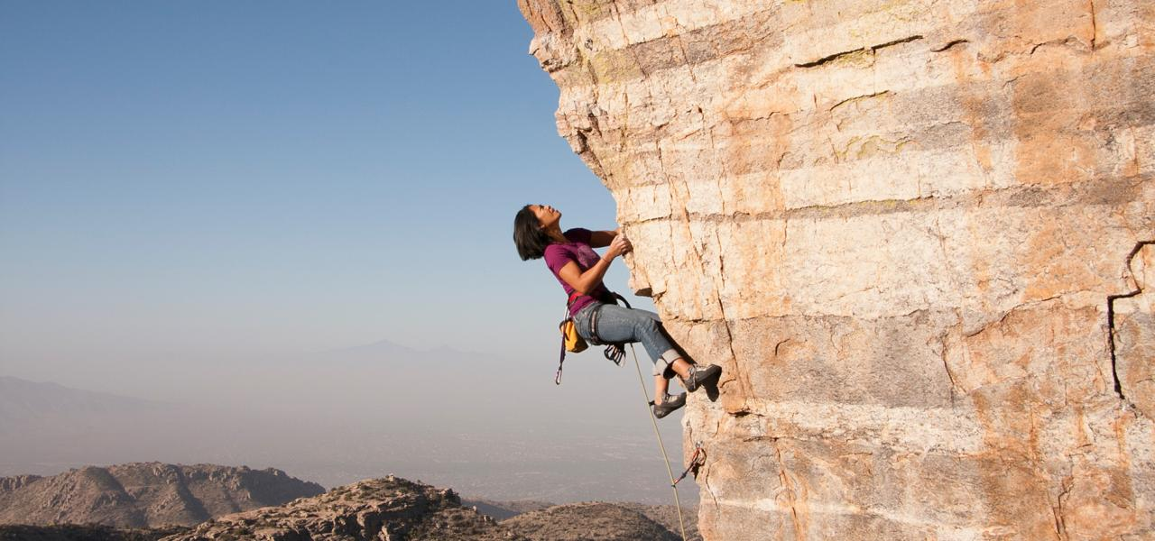
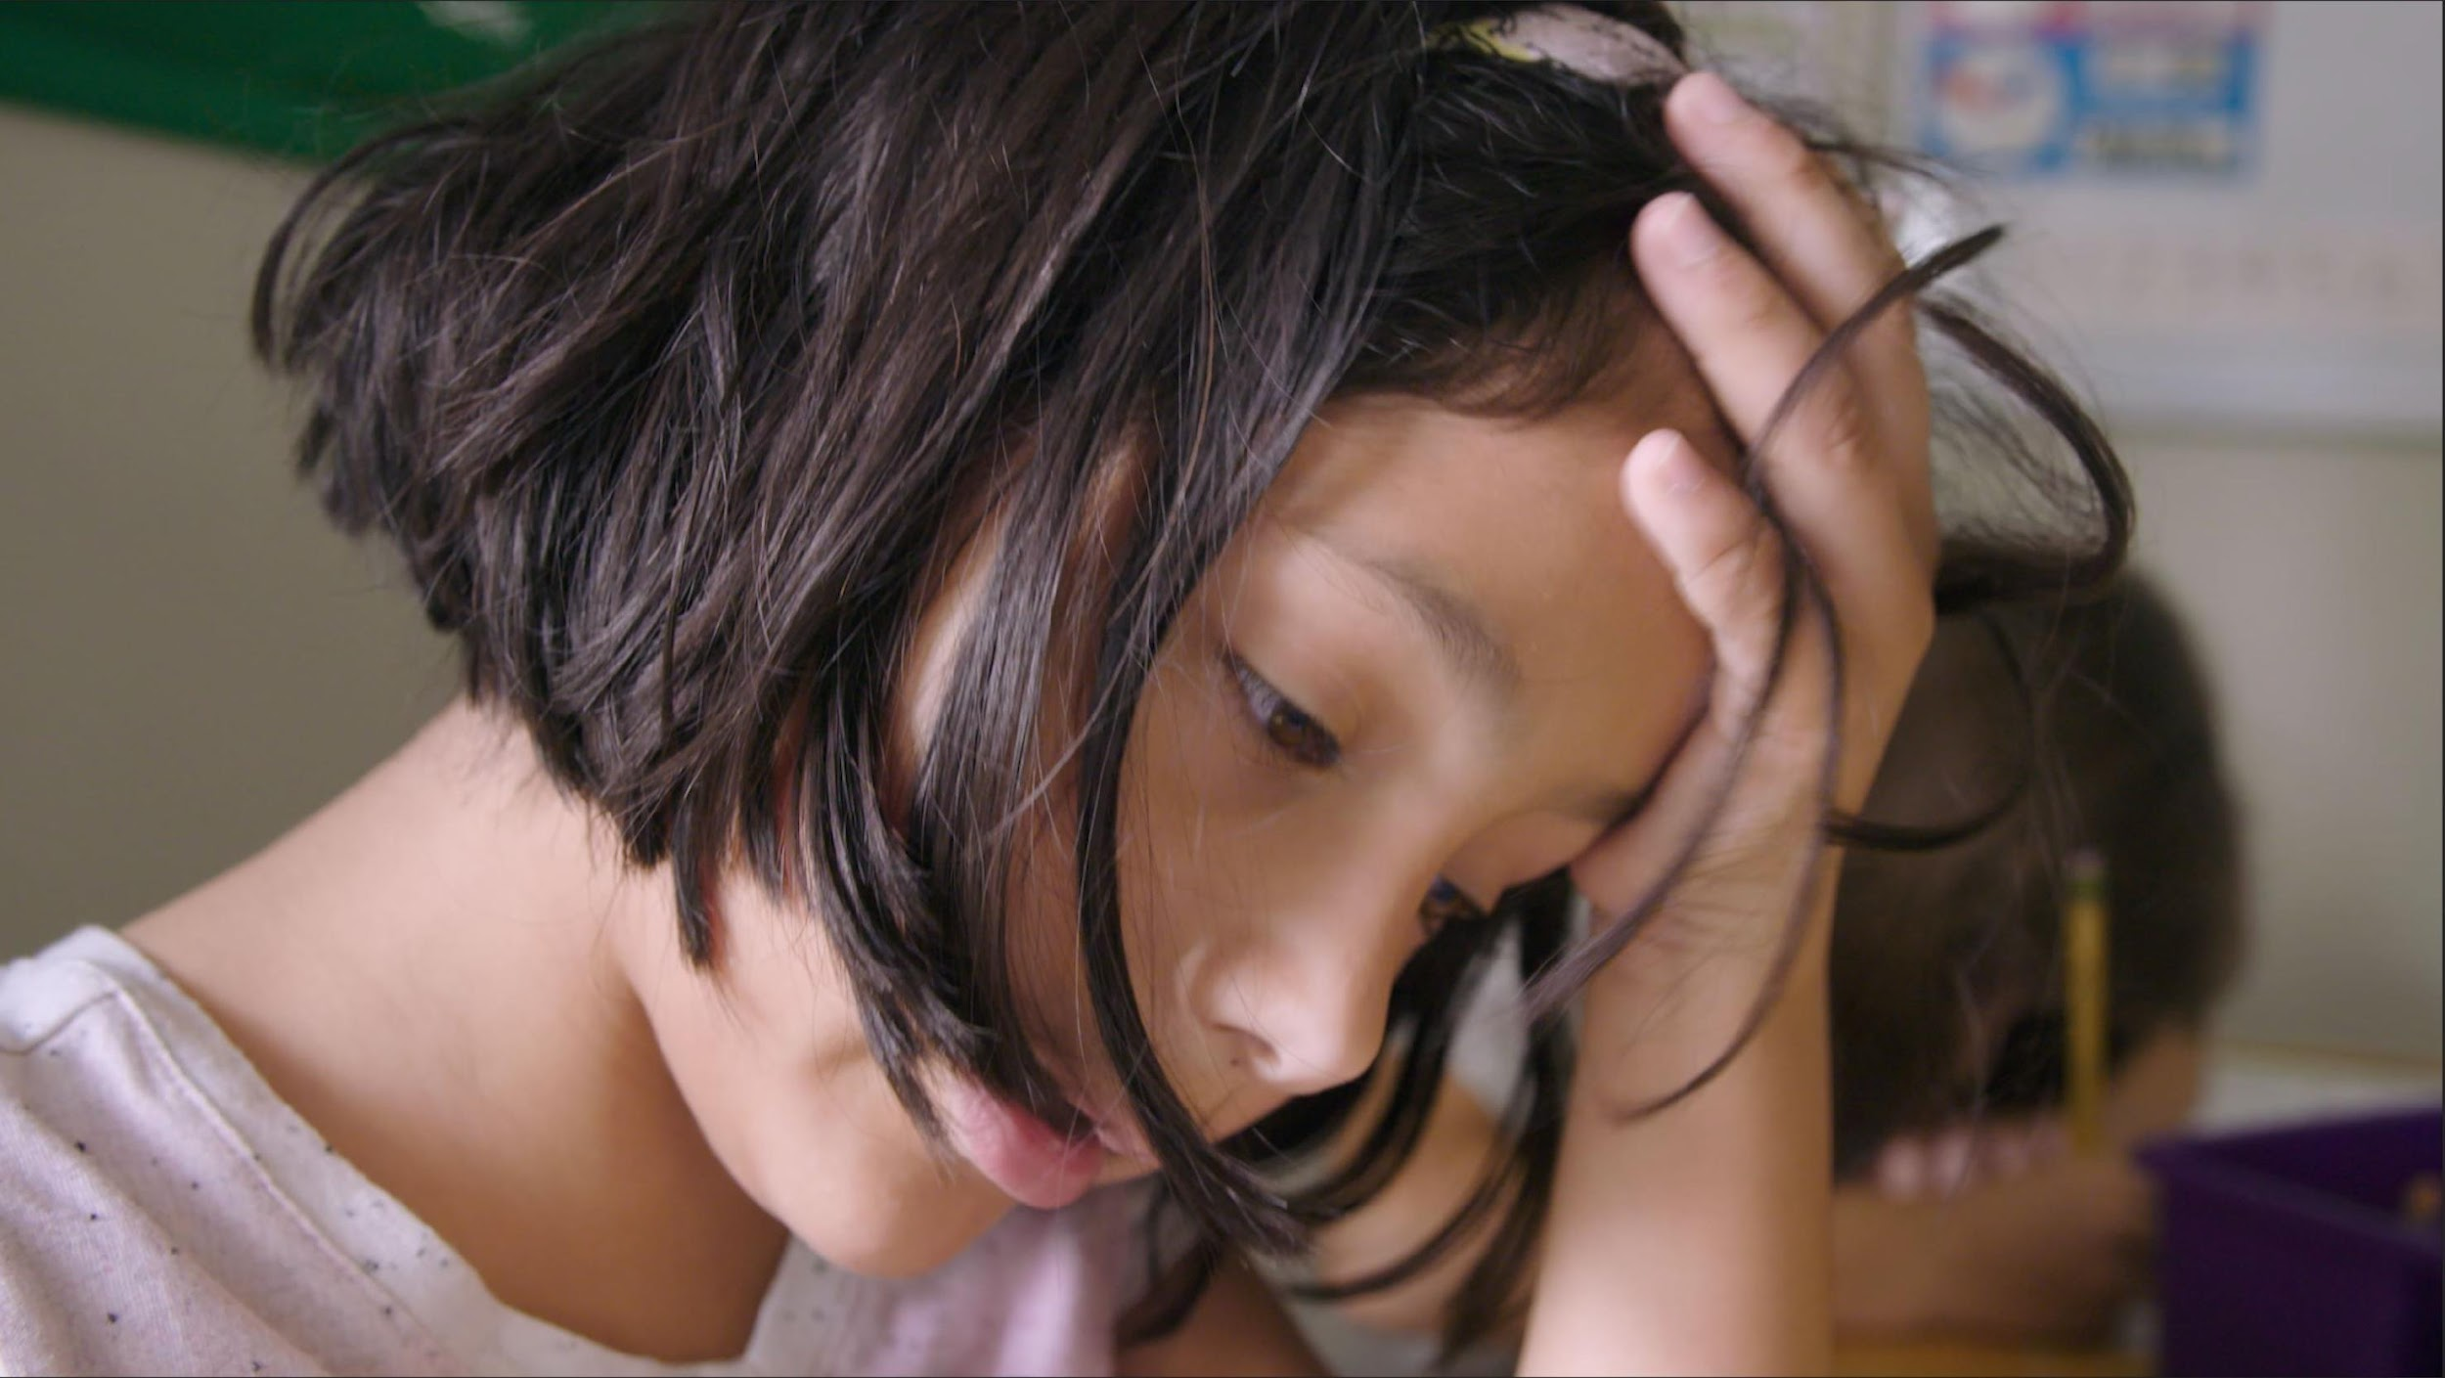
A physiological reaction that prepares an individual to respond to a stressor.
The stressor is usually something that threatens the well-being or homeostasis (stable equilibrium) of the individual.
What is stress?
What is a stressor?
Photo sources: www.discoveravalon.life/best-skiing-western-north-carolina/ , www.visittucson.org/things-to-do/adventure-sports/rock-climbing, People Images/iStock
©2020 Pure Edge, Inc.
Notes:
Use Breathing ball to demonstrate the feeling of stress vs calm by moving it rapidly or slowly.
Ask the group what does stress feel like to you.
Point out that stress is necessary for growth, not all stress is bad.
Curriculum Level: 6-12
Unit: 4
Lesson: 4.4
Page #: 185
Curriculum Theme: Identifying and Regulating Stress
Lesson/Unit Content: "Describe and discuss the benefits of stress regulation in terms relevant to their lives.“

Slide 16


Engaging Activity: Think-Ink-Share
Where do you feel stress in your body?
Where do you feel joy in your body?
www.casel.org
This Photo by Unknown Author is licensed under CC BY-NC-ND
©2020 Pure Edge, Inc.

Slide 17
Benefits
Detriments
Positive challenge
Motivates us to take action
Promotes well-being
Enhances performance
No relief in sight
Makes us physically sick
Weakens immune system
Impairs performance
Marc Brackett, PhD Yale Center for Emotional Intelligence
Victor Carrion, MD Stanford School of Medicine
Follow us @PureEdgeInc
©2020 Pure Edge, Inc.

Slide 18
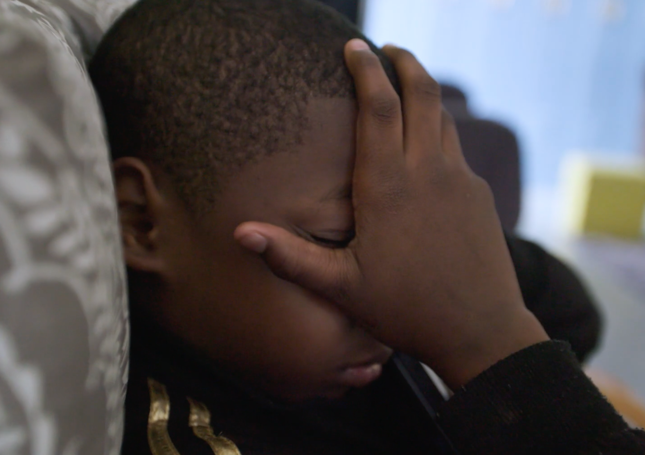
Stress Is Contagious
Higher cortisol levels were found in students whose teachers reported high levels of stress and burnout.
Researcher Kimberly Schonert-Reichl (University of British Columbia) urges educators to be aware of their own mindsets and to practice mental wellness exercises to reduce their stress levels.
Follow us @PureEdgeInc
www.tricitynews.com/news/stress-is-contagious-education-leaders-told-1.24030014
©2020 Pure Edge, Inc.

Slide 19
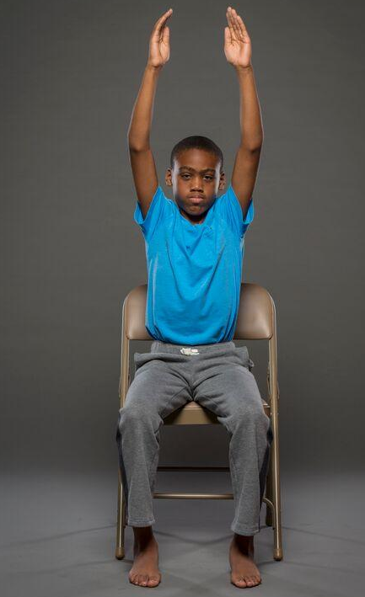
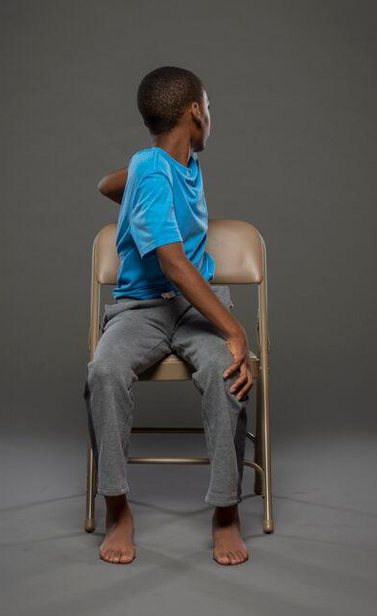
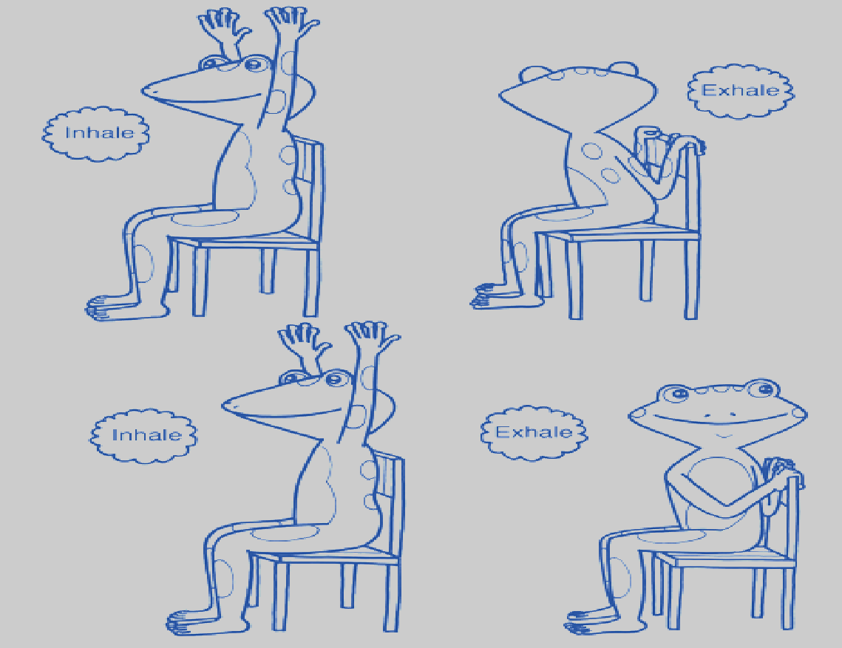
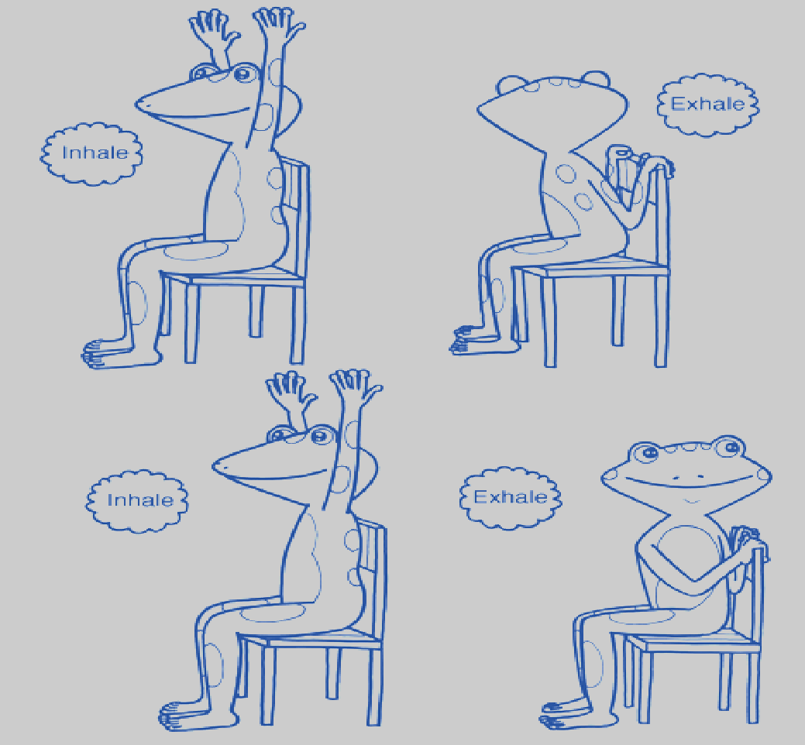
Engaging Activity: Chair Sunrise Twist
Follow us @PureEdgeInc
©2020 Pure Edge, Inc.
Notes:
1. Sit in Seated Mountain.
2. Inhale, stretch arms overhead for Chair Sunrise.
3. Exhale, twist to the right, placing left hand on right knee and right hand on right hip or back of the chair. Keep right shoulder relaxed. Take a few breaths here.
4. Inhale, back to Seated Sunrise.
5. Exhale, twist to the left, placing right hand on left knee and left hand on left hip or back of chair. Keep left shoulder relaxed. Take a few breaths here.
6. Inhale back to Seated Sunrise.
7. Exhale to Seated Mountain.

Slide 20
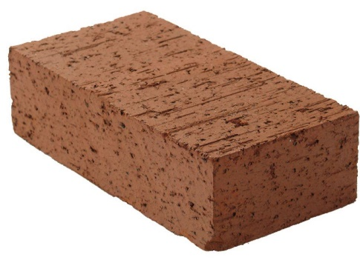



Stress Accumulates **** Allostatic Load
CRISIS
TRAUMA
Allostatic load is "the wear and tear on the body," which accumulates as an individual is exposed to repeated or chronic stress.
PEERS
FAMILY
WORK
HEALTH
Follow us @PureEdgeInc
McEwen, BS; Stellar, E (Sep 27, 1993). "Stress and the individual. Mechanisms leading to disease". Archives of Internal Medicine. 153 (18): 2093–101.
©2020 Pure Edge, Inc.
Notes:
Use backpack analogy: Allostatic load is "the wear and tear on the body" which accumulates as an individual is exposed to repeated or chronic stress.
The term was coined by McEwen and Stellar in 1993

Slide 21
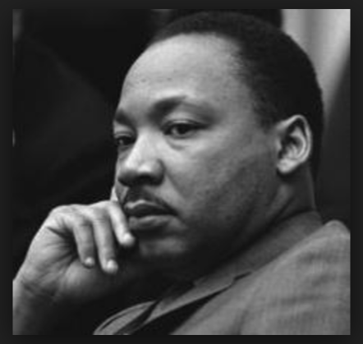
Impact of Stress & Trauma on the Heart
After his death, Dr. Martin Luther King Jr.'s autopsy found that while he was just 39 years old, he had the heart of a 60-year-old.
Follow us @PureEdgeInc
Image Source: https://www.nobelprize.org/prizes/peace/1964/king/biographical/
©2020 Pure Edge, Inc.
Notes:
He took care of a Nation. Emphasize that stress has physiological and long term health impacts.

Slide 22
“
    It is essential for adults working with young
    children to be well physically and emotionally.
    Better health enables better relationships with children, and research has long demonstrated
    that good relationships are crucial for children’s
    learning and social-emotional development.
“
Dr. Kate Gallagher
Director of Research and Evaluation,
Buffett Early Childhood Institute, University of Nebraska
Follow us @PureEdgeInc
©2020 Pure Edge, Inc.

Slide 23

Neurochemicals
Endorphins
Neurotransmitters
Improved mood
Improved memory
Follow us @PureEdgeInc
https://www.kqed.org/mindshift/53681/how-movement-and-exercise-help-kids-learn
©2020 Pure Edge, Inc.
Notes:
Exercise is like getting a bubble bath of all the good neurochemicals for the brain.

Slide 24
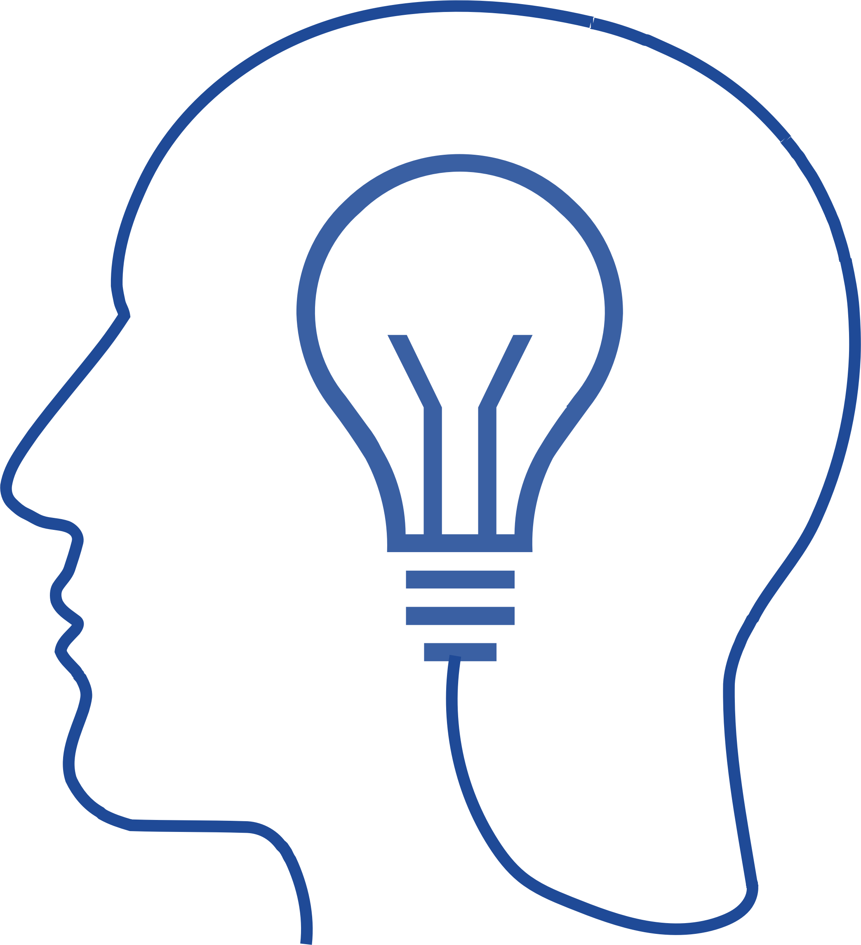
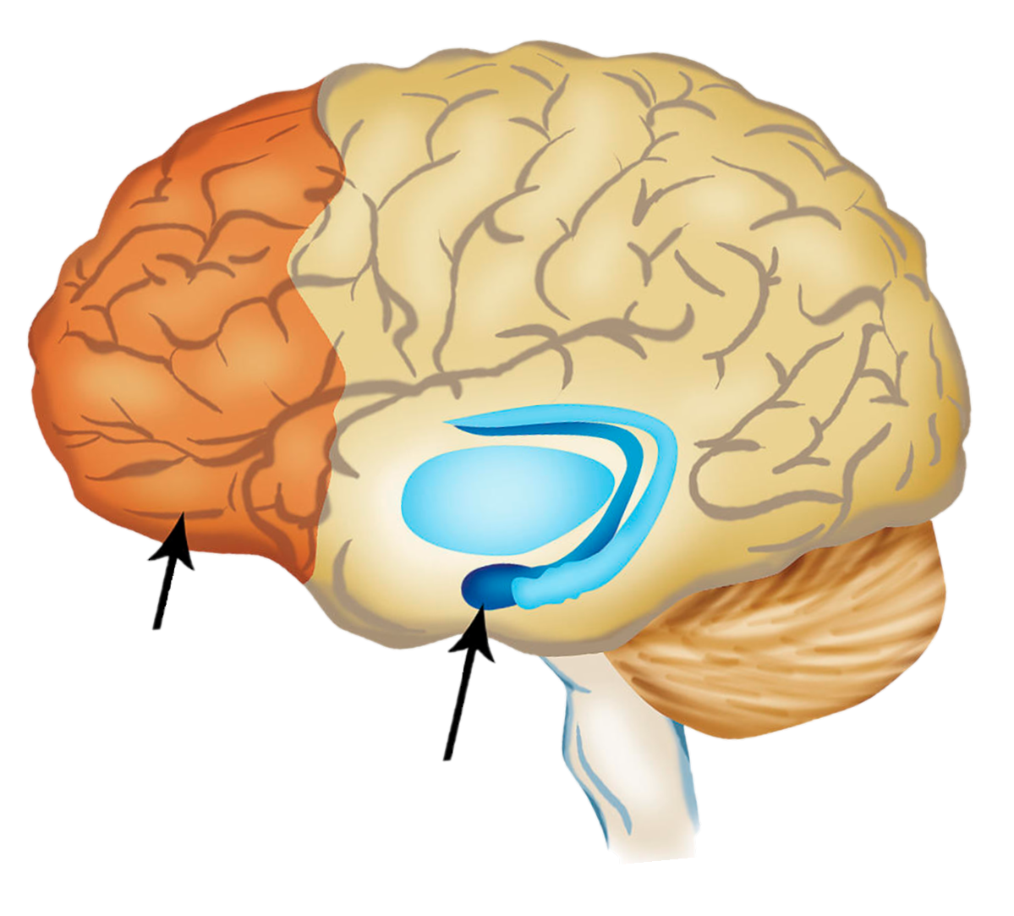
Self-Regulation & the Brain
Prefrontal Cortex
Amygdala
Follow us @PureEdgeInc
©2020 Pure Edge, Inc.
Notes:
Dr. Siegel’s Handy Model of the brain: Flip Your Lid
Define PFC & Amygdala
Breathing strengthens the connection between PFC & Amygdala
PFC NOT FULLY DEVELOPED TILL ABOUT 25 YEARS OLD

Slide 25
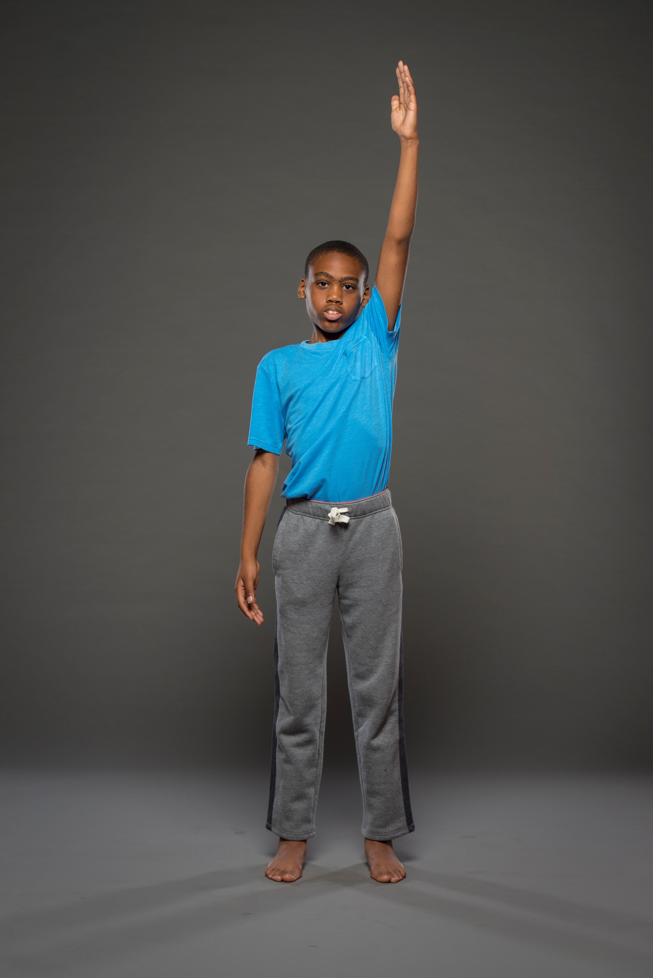
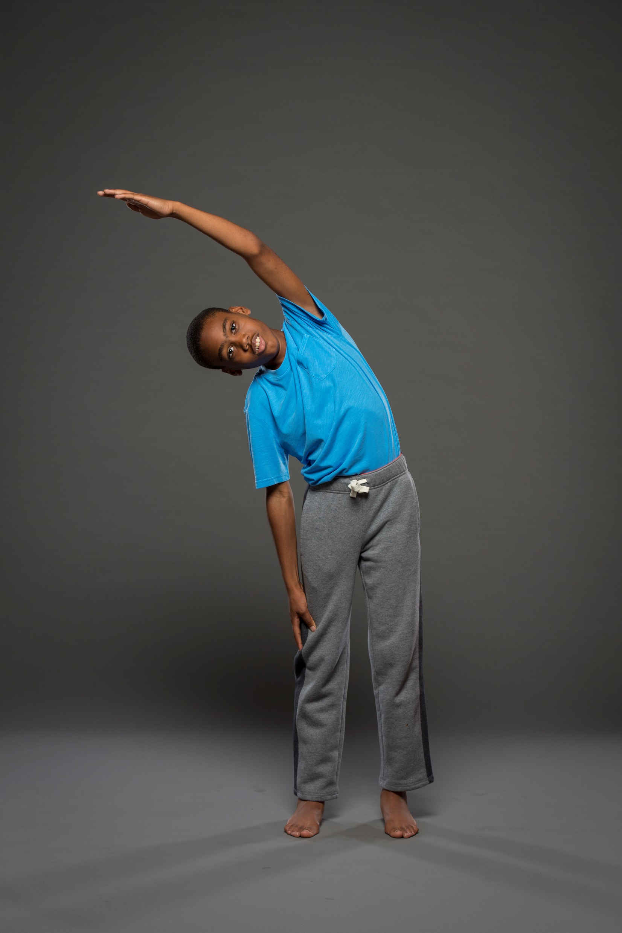
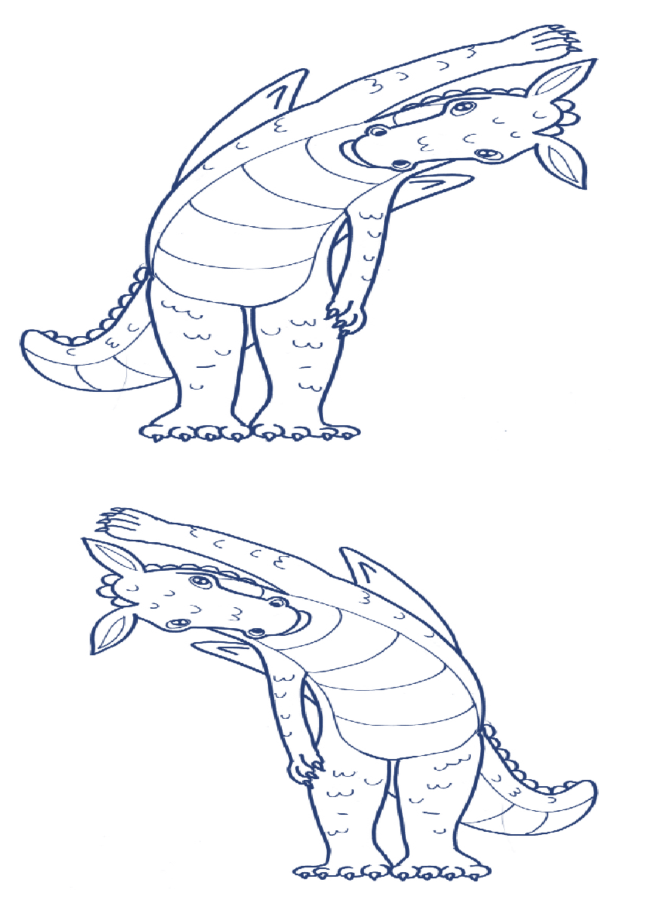

Engaging Activity: Standing Half Moon
Follow us @PureEdgeInc
©2020 Pure Edge, Inc.
Notes:
1. Begin in Mountain Pose.
2. Inhale, take feet slightly apart. Lift left arm overhead alongside left ear, press right arm into right side.
3. Exhale, lean to the right. Gaze straight ahead or down towards the feet.
4. Inhale, return to the center.
5. Exhale, lower left arm.
6. Inhale, lift right arm overhead alongside right ear, press left arm into left side.
7. Exhale, lean to the left. Gaze straight ahead or down towards the feet.
8. Inhale, return to the center.
9. Exhale, lower right arm and step feet together into Mountain Pose.
10. Repeat as required.
*Use this sequence to awaken in the morning or to revive after lunch.

Slide 26


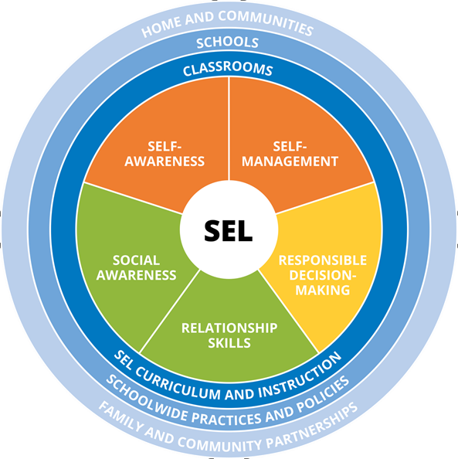
Stress Response
“Gas Pedal”
Sympathetic Nervous System:
Fight or Flight
“Brake”
Parasympathetic Nervous System:
Rest and Digest
https://www.health.harvard.edu/staying-healthy/understanding-the-stress-response
©2020 Pure Edge, Inc.
Notes:
Activating the vagus nerve stimulates your body’s parasympathetic nervous system.
Just like stress can be beneficial, the “fight, flight, freeze or faint” response also has its place. The issue is that too often many of us tend to live in that fight or flight mode. (Give simple example– such as, work stress that you take home with you.)
We want to be able to move efficiently in and out of fight/flight, not get stuck there.
Toning the vagus nerve and enabling our nervous system to function optimally will help us to keep our stress response useful to us, rather than in overdrive.
Source: https://www.health.harvard.edu/staying-healthy/understanding-the-stress-response

Slide 27
Neuroscience is clear.
How we think is affected by
how we feel.
©2021 Pure Edge, Inc.
www.tricitynews.com/news/stress-is-contagious-education-leaders-told-1.24030014.

Slide 28

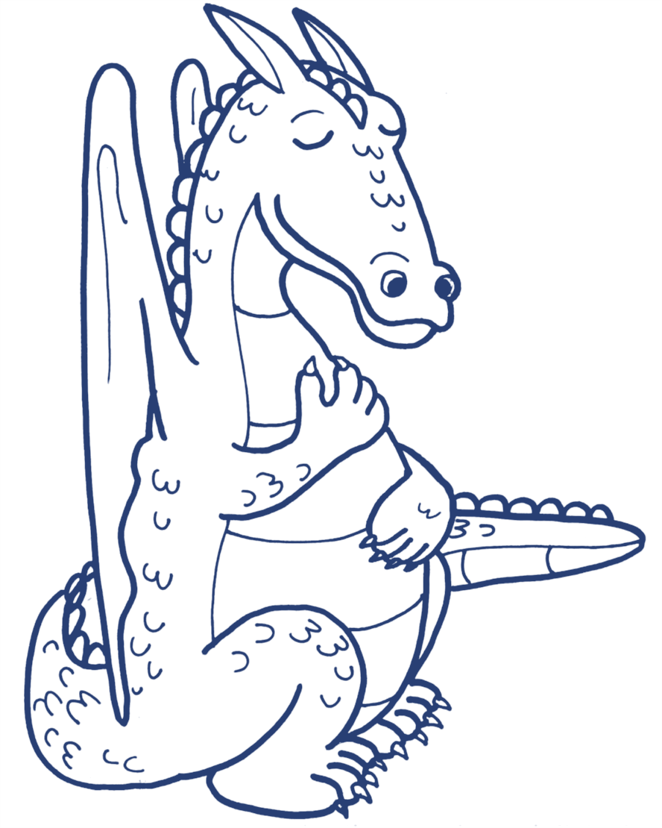
Engaging Activity: Attitude of Gratitude
Sit comfortably, and if you like you can close your eyes.
Think of something/someone in your life for which you are thankful, or grateful. It can be anything or anyone!
Take a few moments to just appreciate this thing or person.
Now think of another thing or person for which you are grateful.
Take a few moments to appreciate this thing or person.
Notice how you feel.
*As you introduce this exercise, you might want to model an example for learners before bringing them through the exercise.
*This is a nice exercise to take a few responses from learners after the exercise is finished.
©2021 Pure Edge, Inc.
Notes:
1. Sit comfortably, and if you like you can close your eyes.
2. Think of something/someone in your life for which you are thankful, or grateful. It can be anything or anyone!
3. Take a few moments to just appreciate this thing or person.
4. Now think of another thing or person for which you are grateful.
5. Take a few moments to appreciate this thing or person.
6. Notice how you feel.
*As you introduce this exercise, you might want to model an example for learners before bringing them through the exercise.
*This is a nice exercise to take a few responses from learners after the exercise is finished.

Slide 29





Gratitude Effects
Decreases heart rate – this may be due to activating the Parasympathetic Nervous System.
Increases our ability to regulate our emotions.
Enhances motivation.
Research Study: Kyeong, S., Kim, J., Kim, D. et al. (2017). Effects of gratitude meditation on neural network functional connectivity and brain-heart coupling. Scientific Reports, 7, 5058.
Source: https://www.psychologytoday.com/us/blog/comfort-gratitude/202009/gratitude-and-its-impact-the-brain-and-body
Follow us @PureEdgeInc
©2021 Pure Edge, Inc.
Notes:
Close with, “over time, as the state of the body is observed, one can begin to clearly observe thoughts and feelings, as well.”

Slide 30
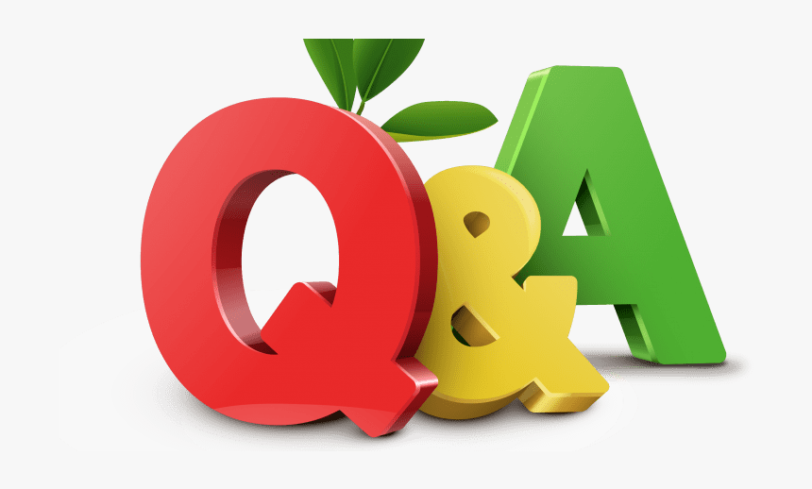
Follow us @PureEdgeInc
©2020 Pure Edge, Inc.

Slide 31
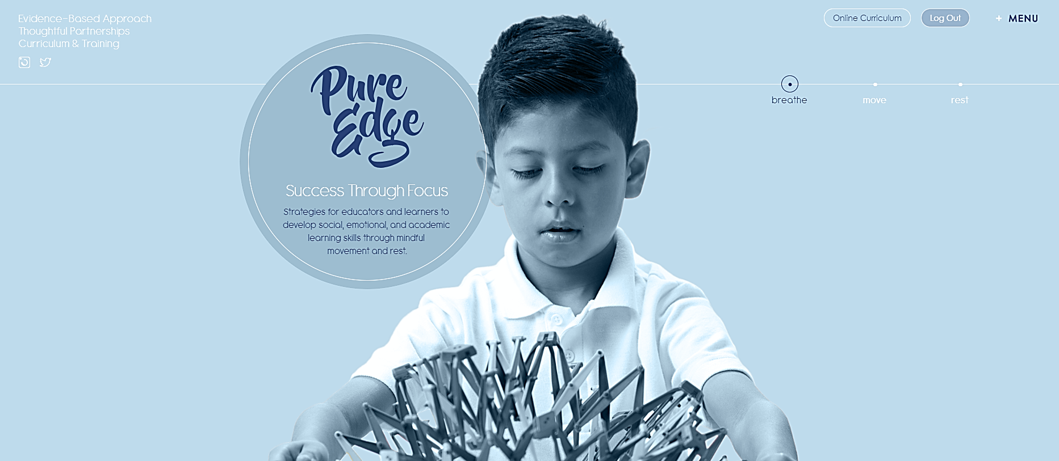
pureedgeinc.org
Follow us @PureEdgeInc
©2020 Pure Edge, Inc.
Notes:
Show how to register for an account. If time allows have them register.
Have them use work email.
Walk them through how to access resources from today’s presentation .

Slide 32
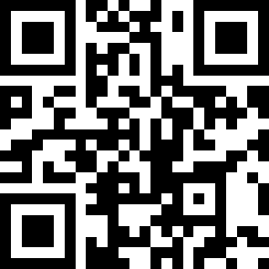

http://tinyurl.com/10-08AEAUT
Follow us @PureEdgeInc
©2021 Pure Edge, Inc.

Slide 33

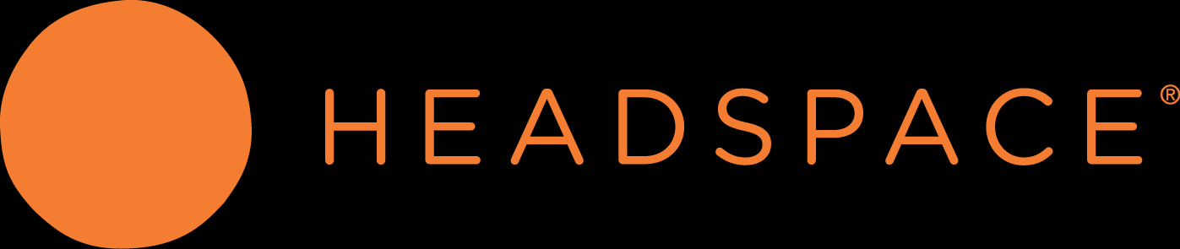
HEADSPACE: Mindfulness On Demand
Headspace is donating their app
to all Educators.
go.headspace.com/pureedge
Use your work email address
Follow us @PureEdgeInc
©2020 Pure Edge, Inc.

Slide 34
Please Note: You will receive a follow-up email within 24 hours of this session. This serves as your confirmation of attendance.
Thank you for joining us!
Session: The Neuroscience of Stress and the Reciprocity of Self-Care
Trainer: Gill McClean, Director of Professional Development
Follow us @pureedgeinc
Website: www.pureedgeinc.org
Email: getmoving@pureedgeinc.org
Follow us @PureEdgeInc
©2020 Pure Edge, Inc.

